Slide 1
What's a Service, Anyway?
Wyatt Pearsall
November 2013

Slide 2
ArcGIS Server Services and its REST API

Slide 3
ArcGIS %@#*!) `*&@%) and its *$@^ ~!$

Slide 4
HTTP
HyperText Transfer Protocol

Slide 5
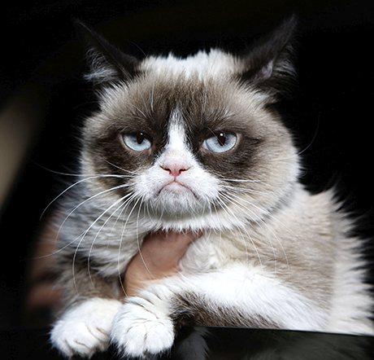
HTTP
HyperText Transfer Protocol

Slide 6
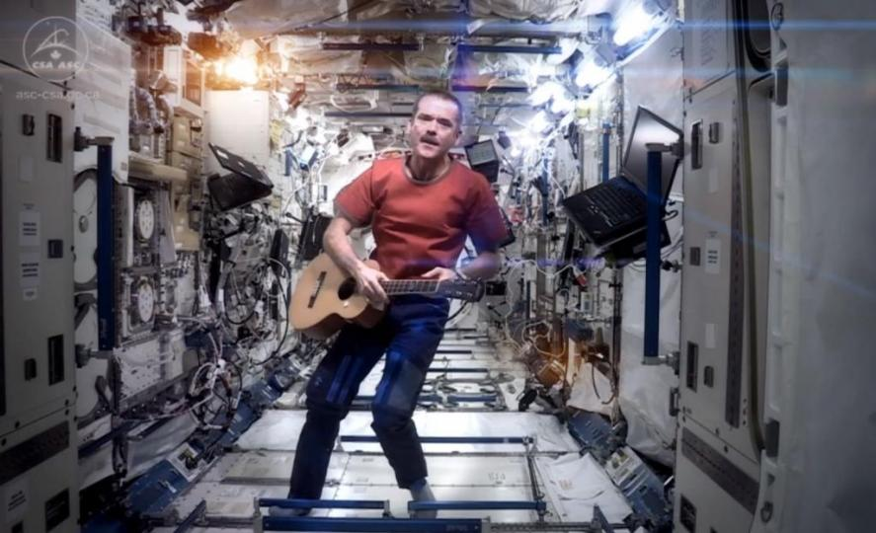
HTTP
HyperText Transfer Protocol

Slide 7
Anything you want!
HTTP is location driven

Slide 8
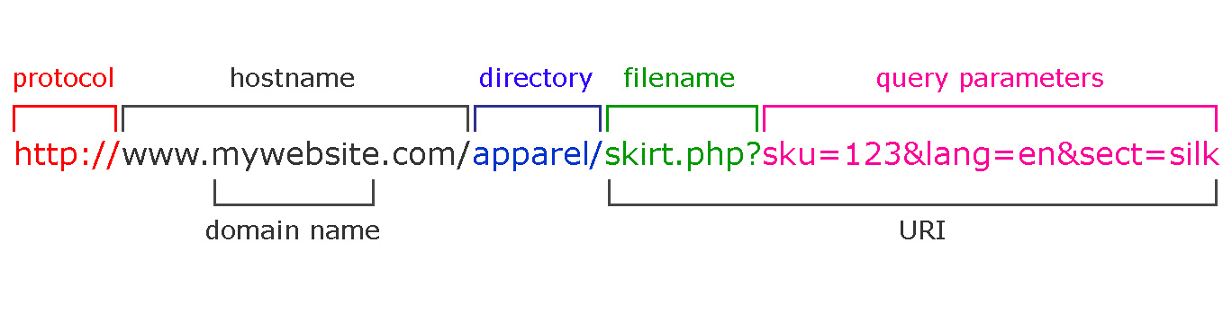
Anything you want!
HTTP is location driven

Slide 9
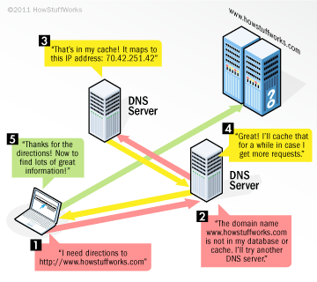
Intricate Dance
Google.com → 64.233.160.17
URL structure allows access to every resource on every computer

Slide 10
EVERY RESOURCE

Slide 11
EVERY COMPUTER

Slide 12
That’s awesome!

Slide 13
That’s awesome!
And powerful

Slide 14
That’s awesome!
And powerful
Accessing any resource just by knowing the URL is what makes the web, the web.

Slide 15
TCP/IP connects computers
Physical wires
Networks
Sending bits over wires
Interpreting bits as information

Slide 16
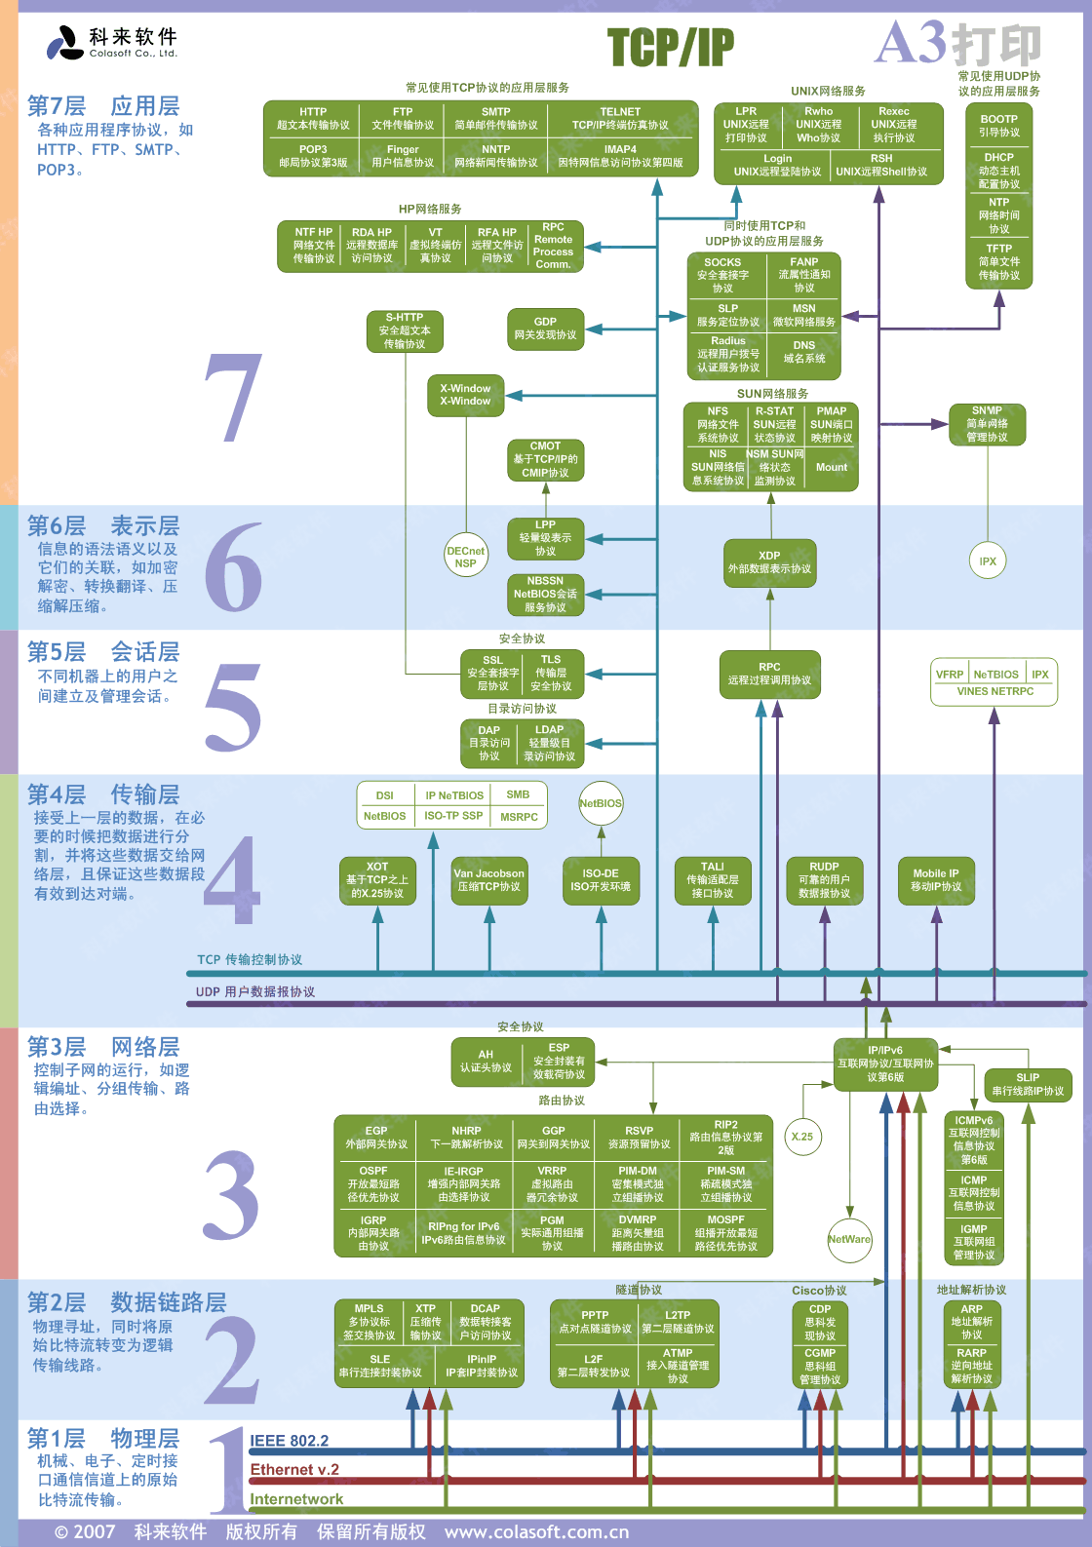
TCP/IP connects computers

Slide 17
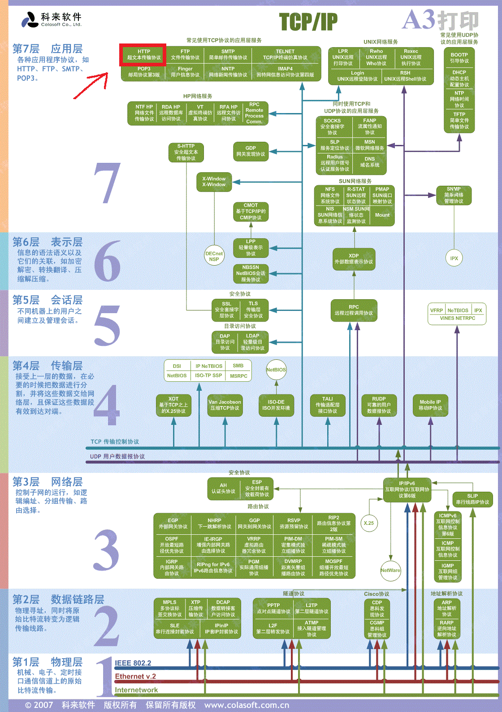
TCP/IP connects computers

Slide 18
TCP/IP connects computers
Focus on HTTP
Everything else might as well be Chinese

Slide 19
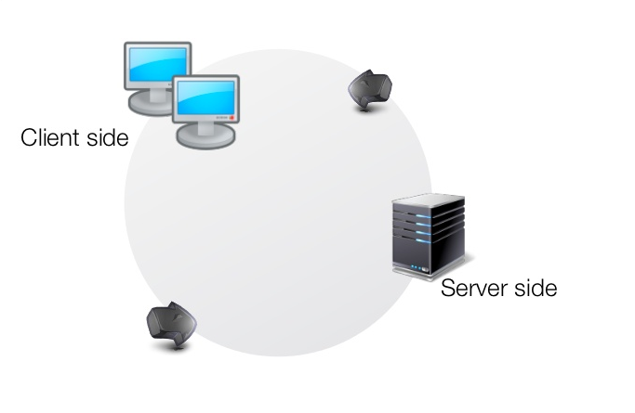
Request/Response

Slide 20
Request/Response
User types URL
Browser makes request to server
Server parses request and responds
Browser shows webpage

Slide 21
Request/Response

Slide 22
Headers organize the cycle
Contain metadata about the request and response

Slide 23
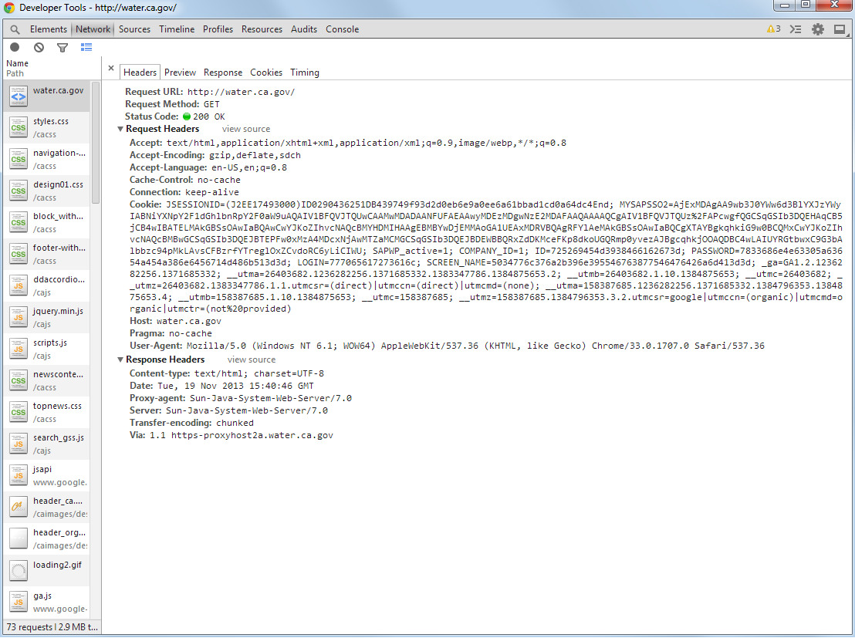
Headers organize the cycle

Slide 24
Request Headers
Host: from whom we are requesting the page
Method: What to do with the resource
Accept: the type of files we’ll accept
Cookie: user information
User Agent: What the client is (browser, web crawler, command line program, screen reader)

Slide 25
Response Headers
Content type: type of file coming back
Content length: file size
Status: what has happened to the request
Most important

Slide 26
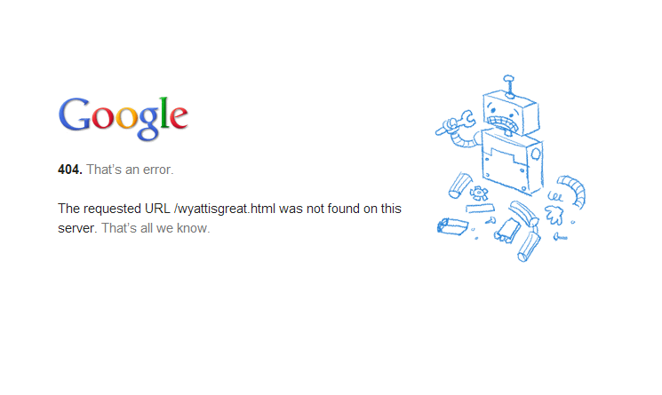
404
Oddly, google can’t find wyattisgreat.html

Slide 27
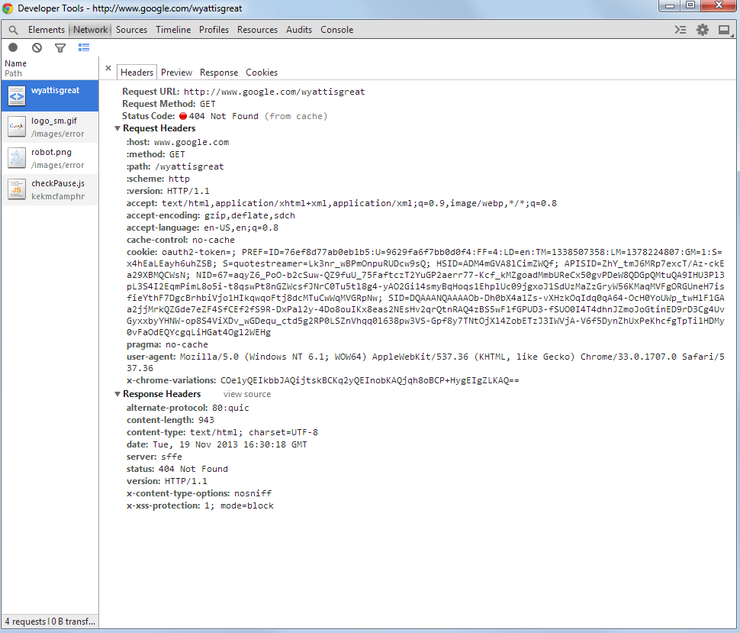
404

Slide 28
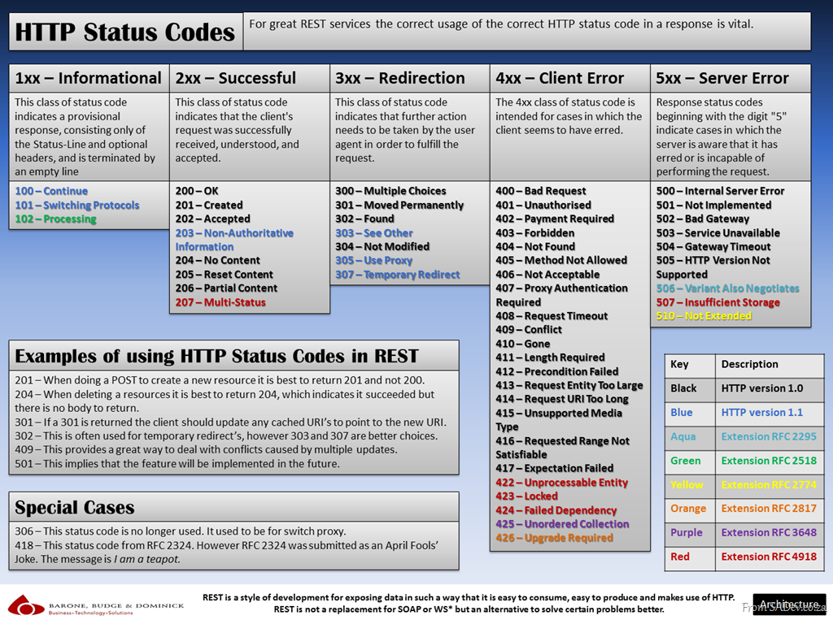
Other codes

Slide 29
Other codes
A little rarer, but you can find them in the wild

Slide 30
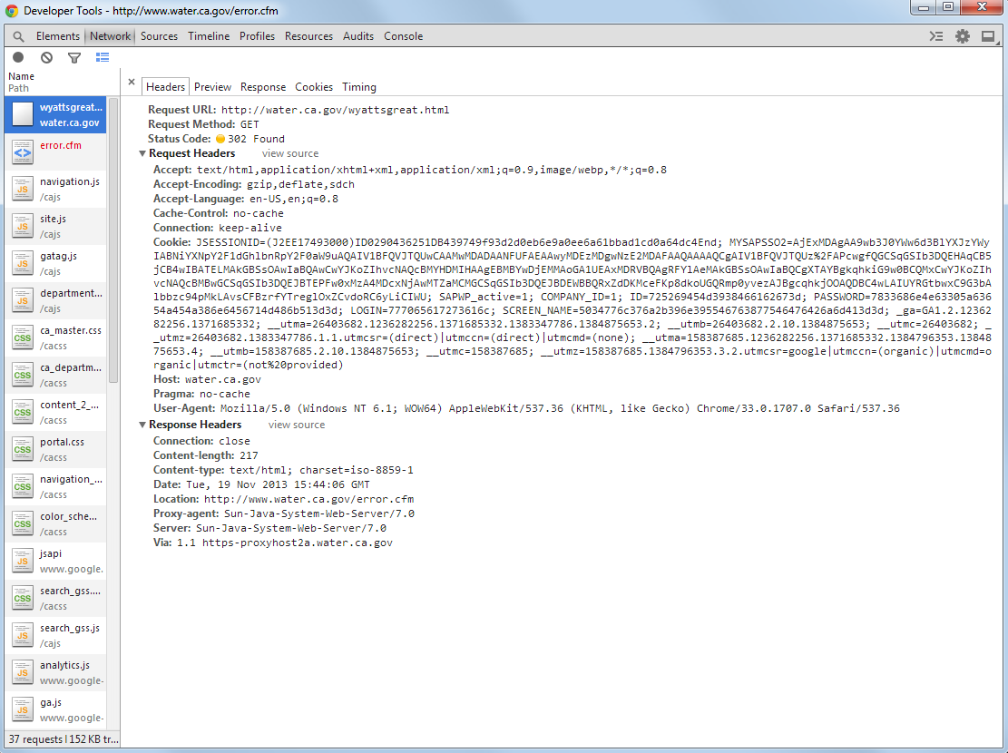
Other codes
water.ca.gov issues 302 Found on wyattisgreat.html… no surprises there.

Slide 31
Codes are Really Important
Standard responses allow for a client to know nothing about a server
Can understand any server that uses codes

Slide 32
Codes are Really Important
Standard responses allow for a client to know nothing about a server
Can understand any server that uses codes
Servers need to know nothing about clients
Can serve any client that understands codes

Slide 33
Request Methods
Like status codes, allow clients and servers to know little about each other

Slide 34
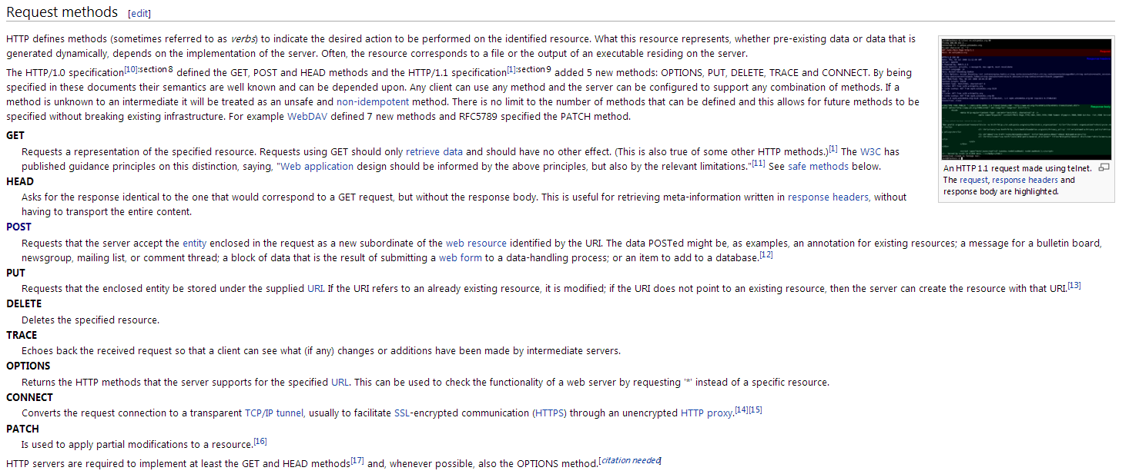
Request Methods
Only 9, only 5 are common.

Slide 35
Request Methods
Often called verbs
Time for a tangent about why using just a few verbs lets us do a lot with little complexity

Slide 36
Linguistic Tangent
Internet is organized to provide access to infinite resources

Slide 37
Linguistic Tangent
Internet is organized to provide access to infinite resources
Resources, as discrete things, are nouns.

Slide 38
Linguistic Tangent
Internet is organized to provide access to infinite resources
Resources, as discrete things, are nouns.
Request methods, as verbs, act upon these nouns

Slide 39
Linguistic Tangent
Most ordinary nouns have many associated verbs
Drive a car, wash a car, crash a car, gas up a car, etc.

Slide 40
Universal Verbs
Some verbs apply to many nouns, like “buy”
You can buy most things:
Buy a car
Buy a can of soda
Buy a book

Slide 41
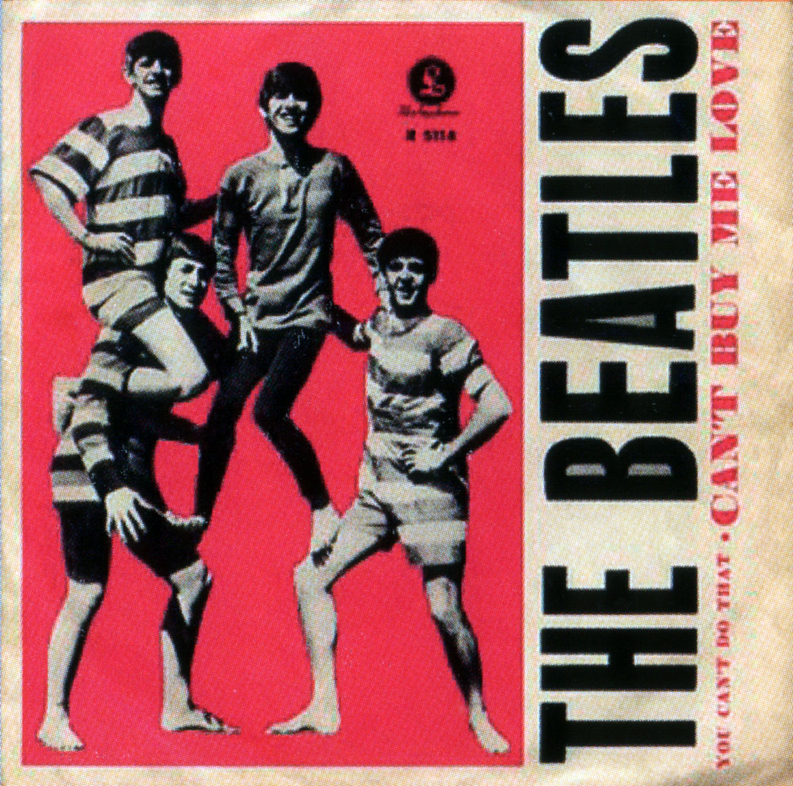
Universal Verbs
Some verbs apply to many nouns, like “buy”
You can buy most things:
Buy a car
Buy a can of soda
Buy a book

Slide 42
Specific Verbs
There are many more verbs that aren’t universal
Can’t drink a book
Can’t drive a soda
Can’t read a car

Slide 43

Specific Verbs
There are many more verbs that aren’t universal
Can’t drink a book
Can’t drive a soda
Can’t read a car

Slide 44

Universal verbs
If limited to just a few verbs, pick the universal ones

Slide 45
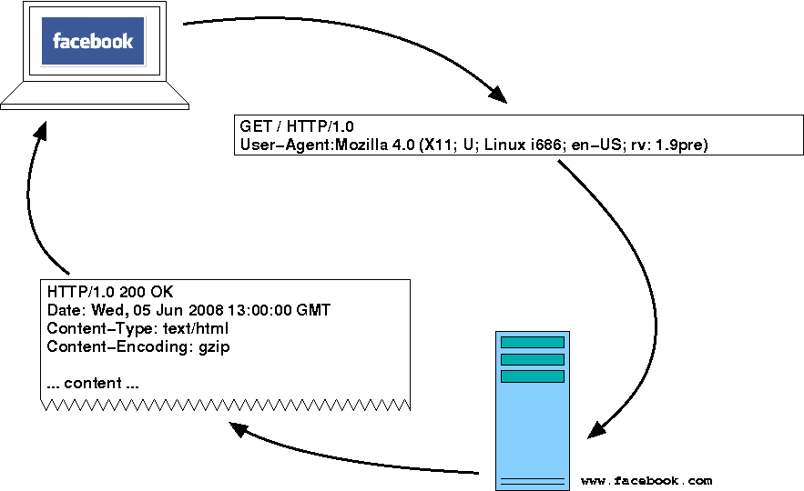
Back to HTTP
This is what HTTP does
Limits itself to common verbs like GET, POST, PUT, and DELETE

Slide 46
Less is More
With just a few verbs, clients don’t need to know about the capabilities of implementations of a server
Development of browsers and servers can advance without each of them having to know about an entire internet full of proprietary commands

Slide 47
Services?

Slide 48
Services!

Slide 49
Get to the REST
These ideas of HTTP apply to REST
(REpresentational State Transfer)
So we’re on the right track

Slide 50
But first
Big enterprise players started championing SOAP (Simple Object Access Protocol) as a way for systems to communicate.
Remote Procedure Call where XML encodes a series of commands that can be run on a computer and a communication layer is built to allow messages to be passed back and forth in XML to run these specific commands.

Slide 51
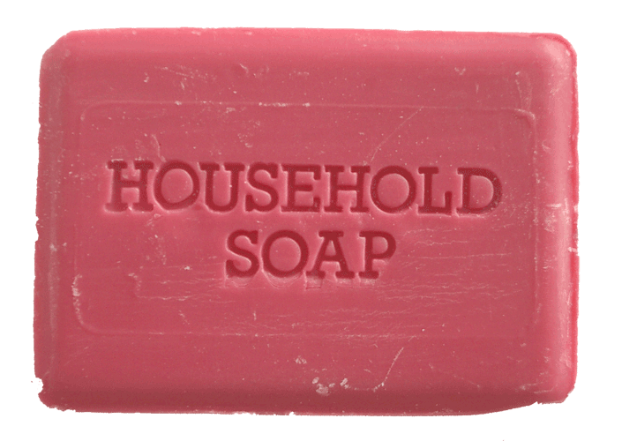
SOAP
If it sounds complicated, that’s because it is
There are many complex extensions and specifications

Slide 52

Roy Fielding

Slide 53
REST: HTTP is a good idea
If the web is so successful, systems should interact in the same way.
Client/Server separation
Uniform Interface (few verbs)
Caching
Network requests are the slowest thing a computer can do besides load bathymetry points in ArcMap

Slide 54
REST: HTTP for systems

Slide 55
APIs
APIs are a structured way for programs to communicate
A key to using someone else's complex program in a simple, defined way.

Slide 56
Facebook
Facebook has petabytes of data on their servers and very complicated ways of ordering, storing, and searching this data.

Slide 57
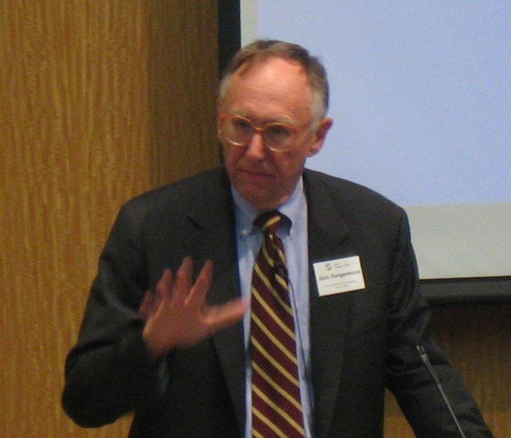
Facebook
https://graph.facebook.com/137595352936906/picture?type=large

Slide 58

Facebook
https://graph.facebook.com/95205192448/picture?type=large

Slide 59
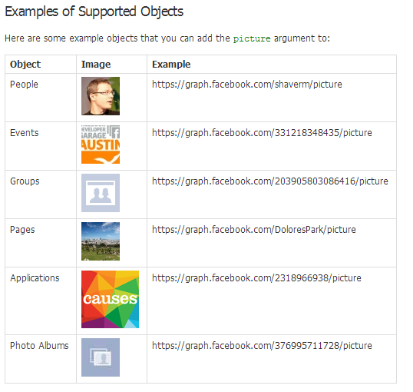
Facebook
Plugging in the PageID of these pages into a URL structure defined by the facebook API results in the requested images

Slide 60
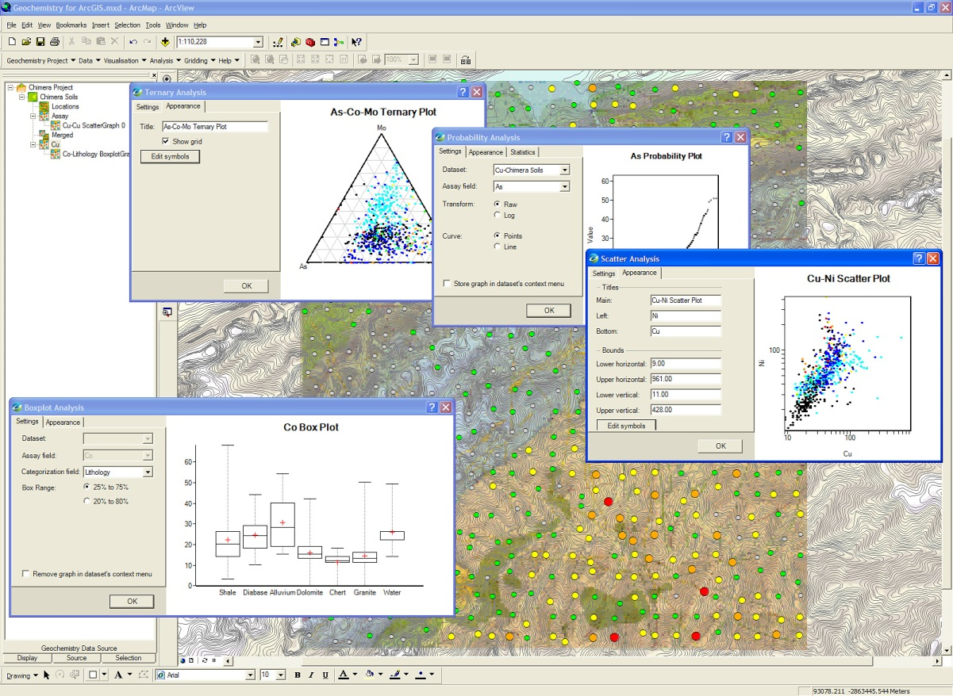
User Interface for Developers
With a normal user interface, you might click a link or button, start typing in a form, or press the back button if you are browsing the web.

Slide 61
User Interface
Common tasks which have expected responses
If a link doesn't take you where you expect, a field doesn't work like you think it should or if a website hijacks your back button.. it is a problem.

Slide 62

Users hate it

Slide 63
UI is a contract
You have to adhere to a contract that your software will do what a user expects it to do.
When you fulfill this contract, your application seems intuitive.
When you break it, your users will leave

Slide 64

Unless they can’t

Slide 65
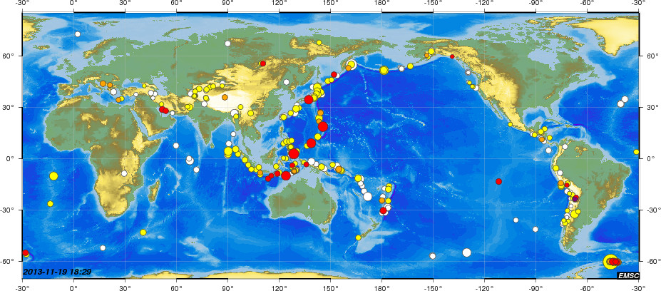
APIs: Contracts for Developers
APIs seek to allow straightforward communication with a service
Whether it is a Twitter Client tweeting on a user's behalf, or a map showing USGS earthquake data, APIs exist to allow easy access to complex applications and vast amounts of data.

Slide 66
What’s a Service Anyway
A service is a self-contained program used through an API to provide its functionality to a client or user.
REST is often used to keep the concerns of the service separate from the client so that it can be maintainable and scalable.

Slide 67
Where’s the GIS
So how does this apply to all of you?

Slide 68
You Can Create Services
Publish a map to ArcGIS Server
Click through some dialogs in ArcMap
These services become immediately available for use by any client that can navigate the API

Slide 69
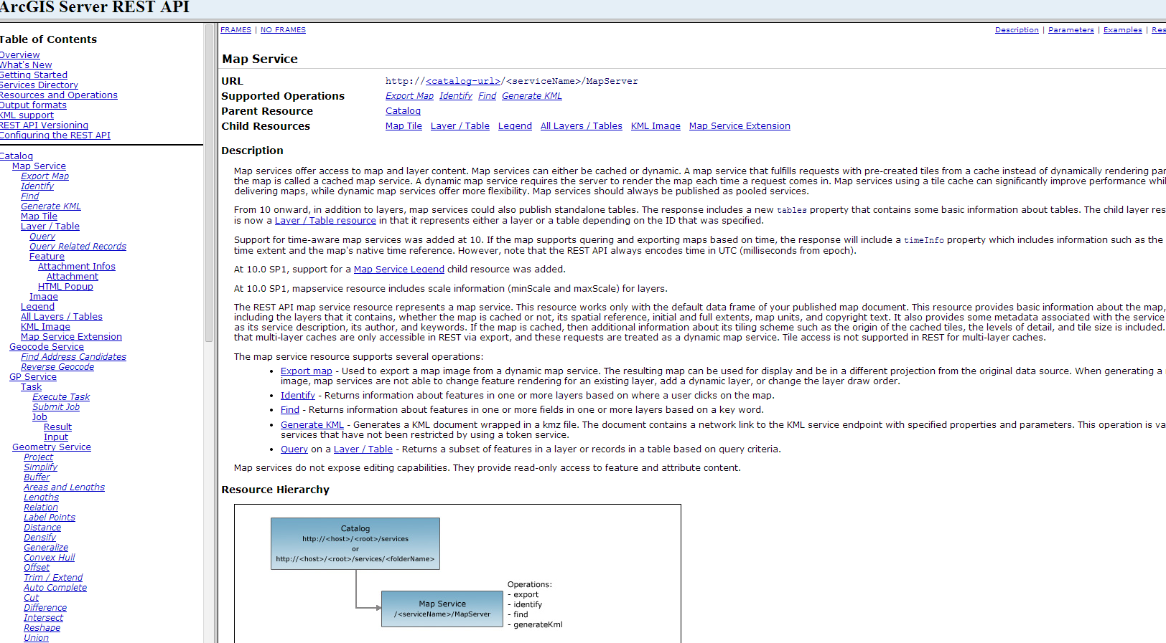
ArcGIS Server REST API

Slide 70
ArcGIS Server REST API
URL of the resource
Operations you can perform
How it relates to other resources.

Slide 71
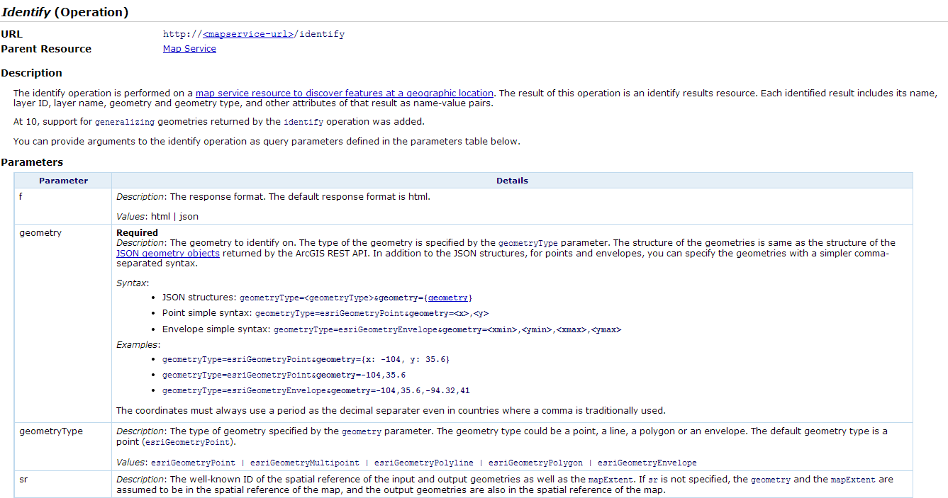
Identify

Slide 72
Identify
Operate denoted by URL
By supplying proper parameters, can identify just like in ArcMap

Slide 73
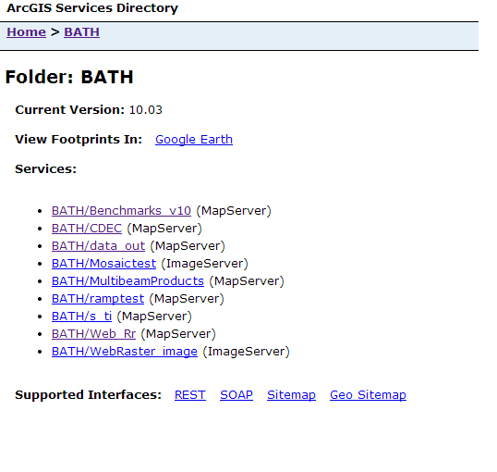
RESTful Service Endpoint

Slide 74
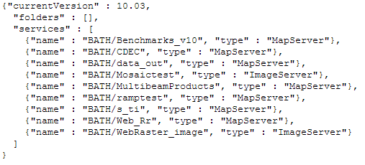
REST

Slide 75
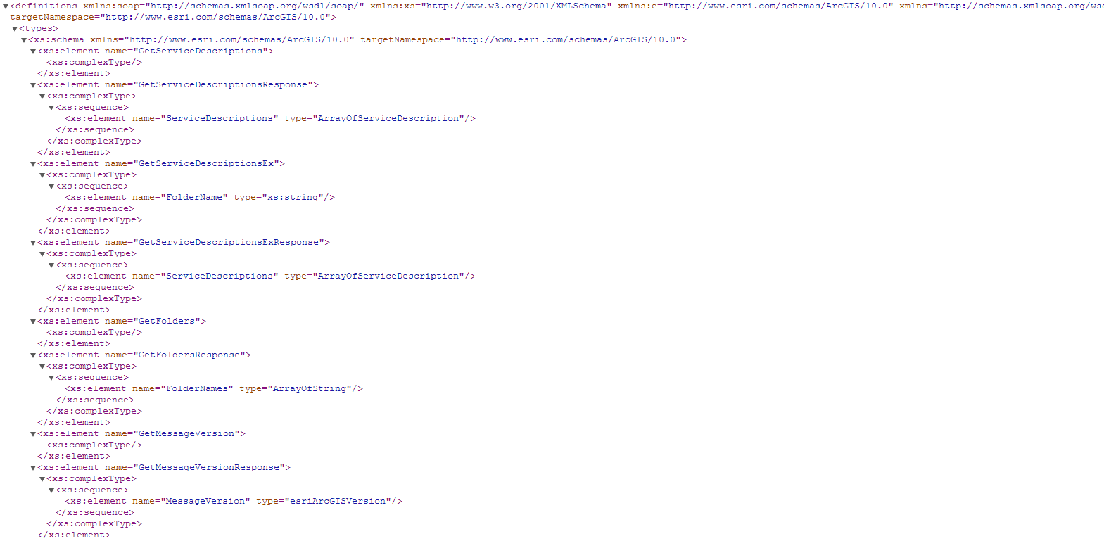
SOAP

Slide 76
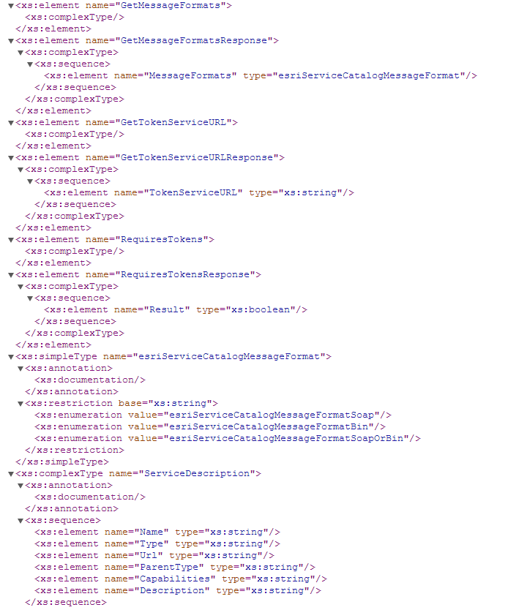
SOAP

Slide 77
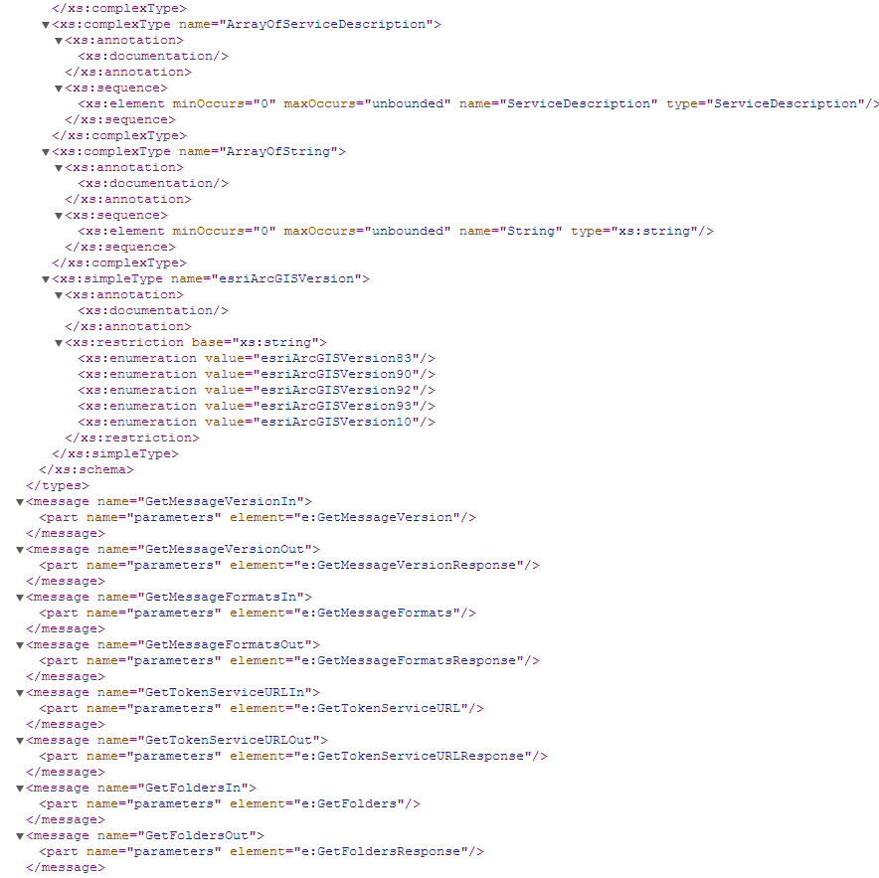
SOAP

Slide 78
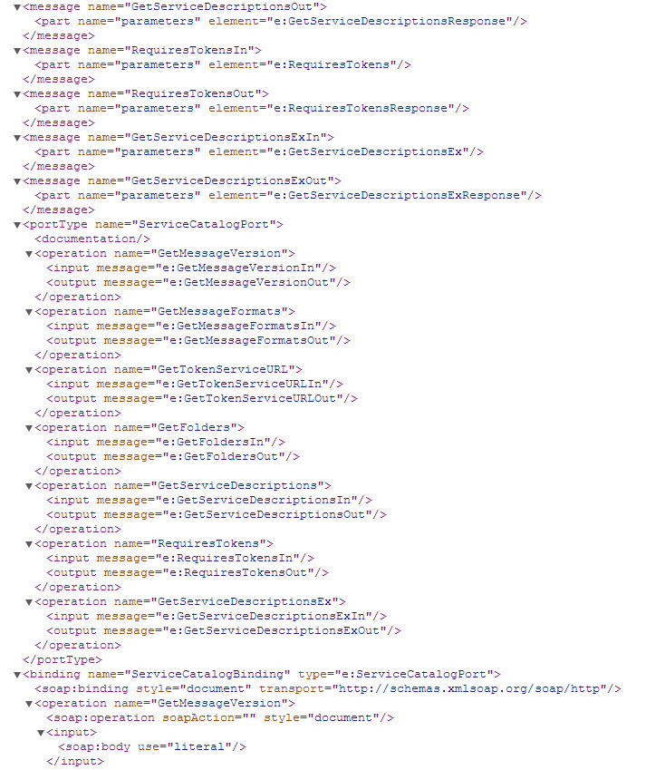
SOAP

Slide 79
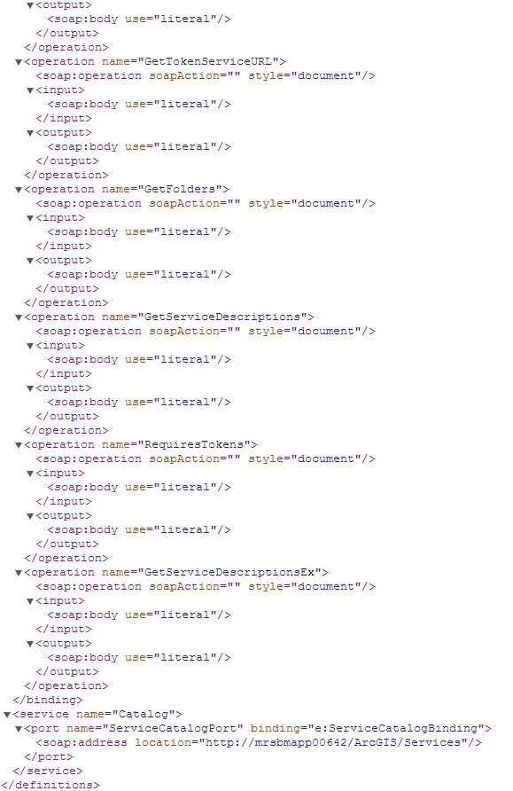
SOAP

Slide 80
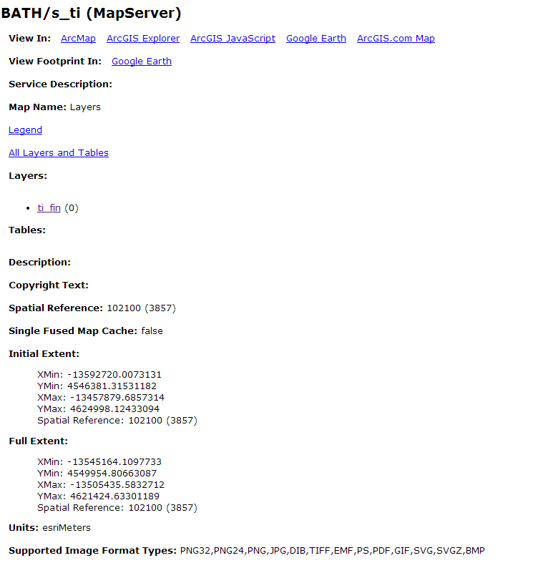
Inspect a service

Slide 81
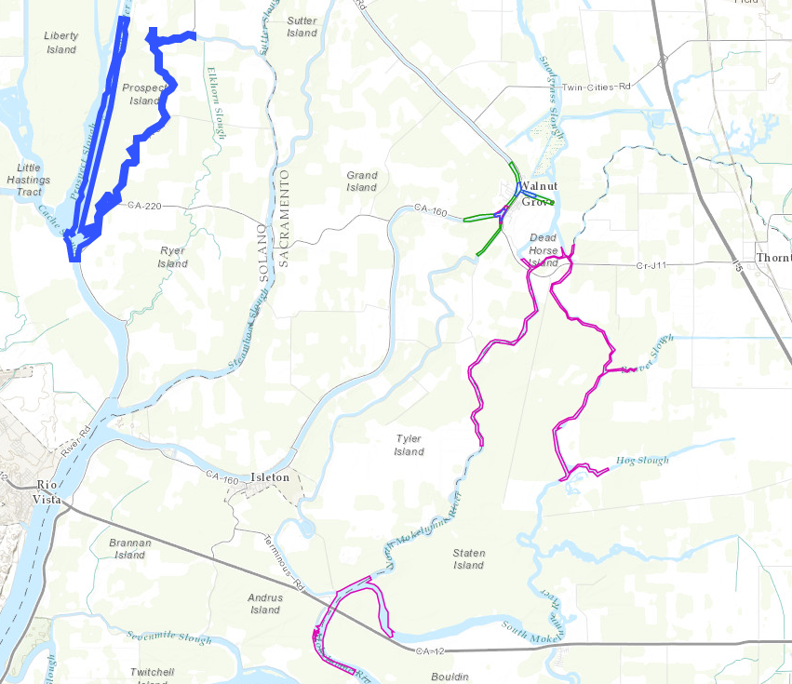
Consume a service

Slide 82
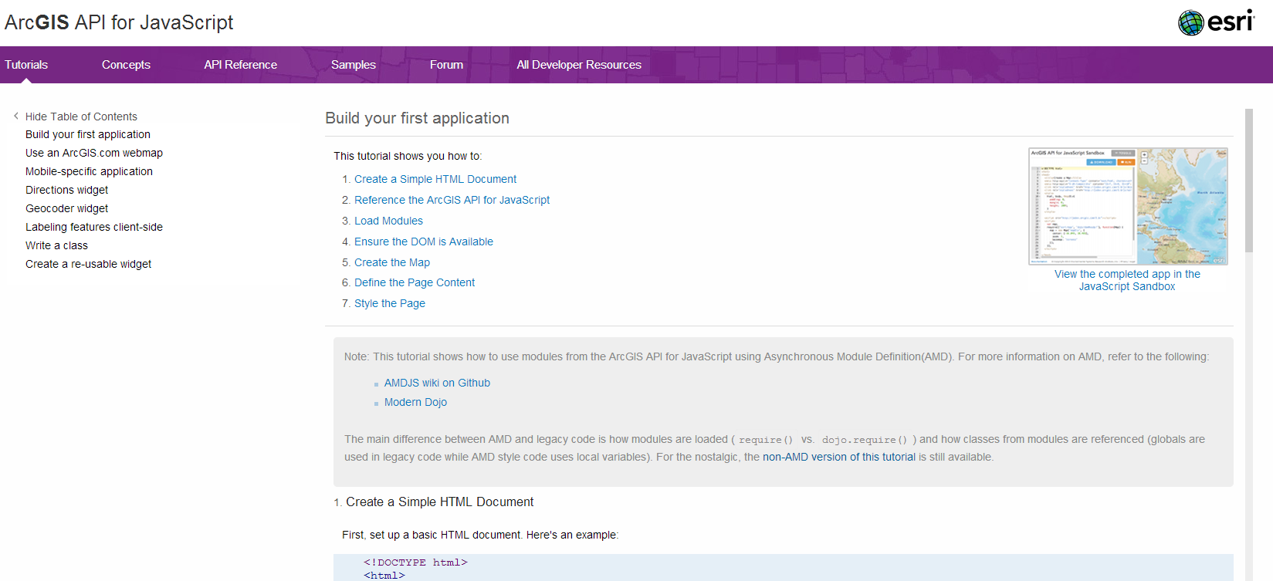
JavaScript API
Don’t need to use Server API directly
Use the JavaScript (or Silverlight or Flex) APIs to quickly build a useful application.

Slide 83
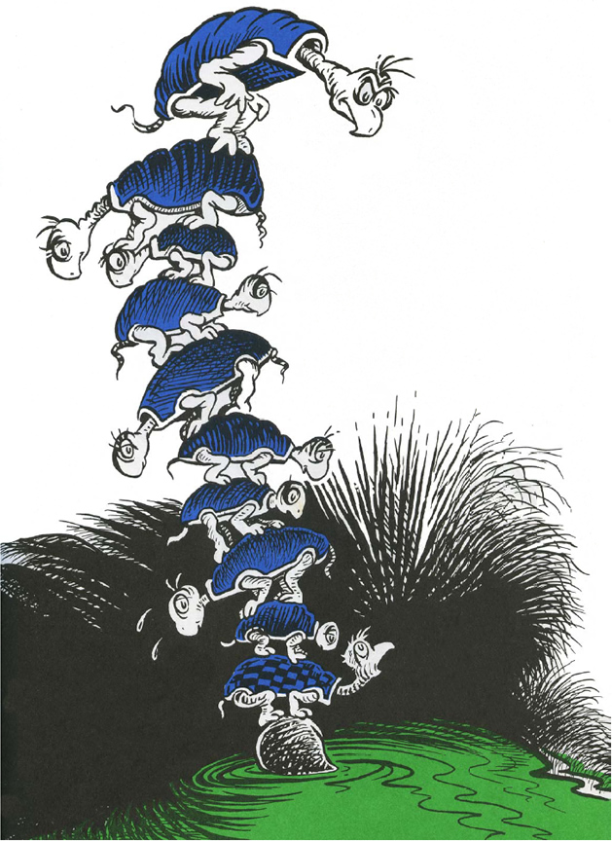
JavaScript API
These APIs encapsulate the Server API, allowing access to data from powerful programming environments.
APIs all the way down

Slide 84
ArcGIS Server Services and its REST API?

Slide 85
Self contained programs, with a defined, simple interaction mechanism, based on familiar, performant technology.

Slide 86
Questions?

